Slide 1
Comparative Analysis and Optimization of Hydropathy Scales for Predicting Core InteractingResidues in Protein Interfaces
dsmp-2024-groupt3 | Mini-Project, Bristol University
Pulkit Dhingra, Luoxi Liu, Shaivya Shankar, Shuyi Li

Slide 2

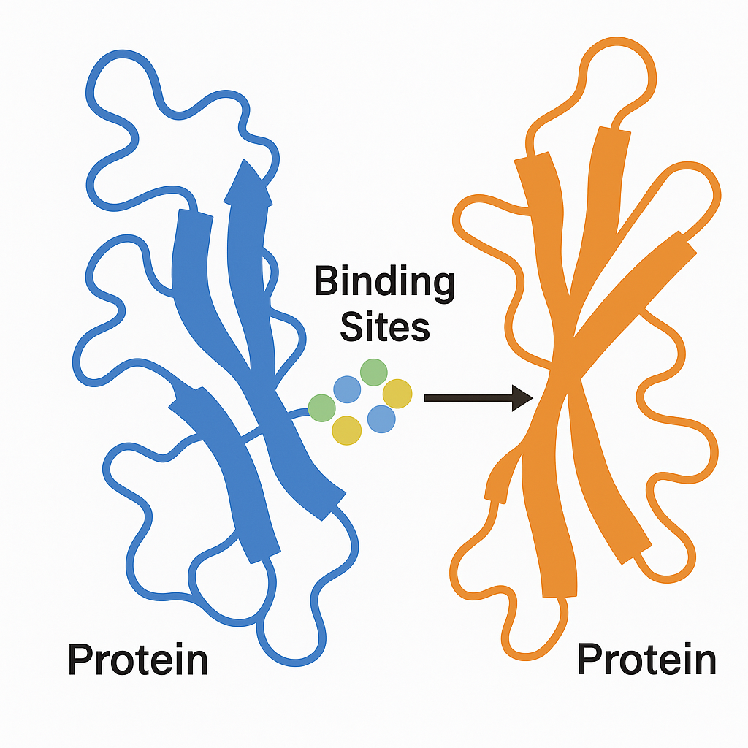
Overview
Introduction to Protein Binding
→ Proteins often function by forming complexes through protein-protein interactions → These interactions occur at specific binding sites involving residue pairs from two protein surfaces
Residue Pairs and Binding Challenge
→ Not all residues participate in binding — only certain core interacting residues form stable contacts → Predicting which residue pairs bind is crucial for understanding molecular mechanisms and for drug design
Our Task
→ Task I: Analyze hydropathy impact on identifying interacting residue pairs → Task II: Compare hydropathy scales and define a new combined scale using PCA

Slide 3


Data Sources
Dataset/
├── test/
│ ├── classification.txt/
│ ├── dataset.txt/
│ ├── dist.txt/
│ ├── shape.txt/
│ ├── hr.txt/
│ ├── el.txt/
├── train/
│ ├── classification.txt/
│ ├── dataset.txt/
│ ├── dist.txt/
│ ├── shape.txt/
│ ├── hr.txt/
│ ├── el.txt/
Hydropathy Scales (27 +1 Files)
Our Understanding of the data source files and formats
Data.txt :- This file represents the residueA along and residueB along with 9 different neighbours of the B.
Hr.txt :- This files contains hydropathy value which has been computed using the given formula. Where Ha and Hb represents the hydrophobicity values of residue A and B. “a” and “b” value which was originally given to us 0.033 and 0.363.
El.txt :- Electrostatic complementarity between A_n and B_n and between A_n and the eight neighbours of B_n.
Dist.txt :-This represents the distance between residue A_n and residue B_n and between residue A_n and the nine neighbours of B_n.
Shape.txt :- Shape complementarity between A_n and B_n and between A_n and the nine neighbours of B_n
Classification.txt :- Contains actual labels for the training dataset

Slide 4

Task 1:
Analyze hydropathy impact on Identify interacting residue pairs

Slide 5
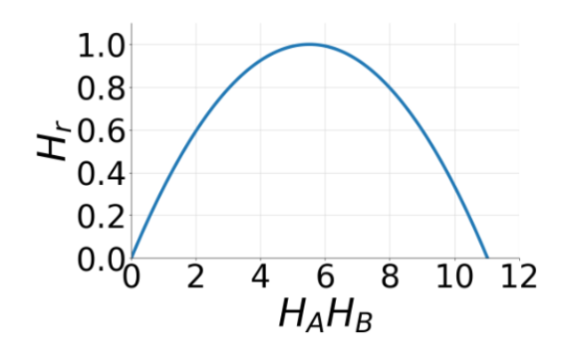
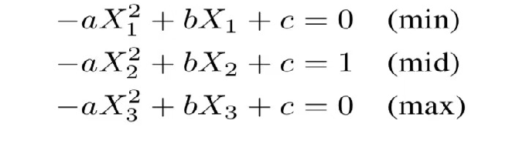
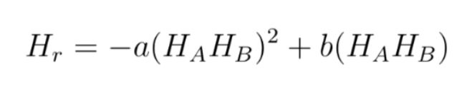
Formula Modifications Success and Failures
✅ Task 1 required generating hr.txt files using 27 hydropathy scales.
❌ The provided formula couldn't generate valid Hr values for all scales.
Our Work:
• Modified the original formula to adapt to new scale values.
Compared with the given formula, the modified formula adds a new parameter c. Where X1 represents the minimum value of HA * HB, X2 represents the median value, and X3 represents the maximum value of HA * HB. And 0 and 1 correspond to the maximum and minimum values of Hr respectively.
It can handle negative values without shifting the scale
Skewed distribution of data made it hard to identify the median value of HA * HB accurately.

Slide 6

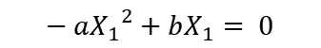
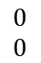
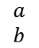
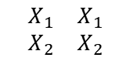
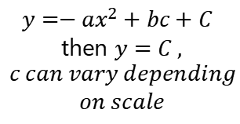
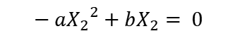
Math's Behind Our Work
Using each scale we need to find the Hydropathy values based on residue pairs
$$y=−{ax}^{2}+bc+C$$
then $y=C ,$
$$c can vary depending$$
$$on scale$$
We need to find ‘a’ and ‘b’ values for each scale
Max Point
$$−{{aX}_{1}}^{2}+{bX}_{1}= 0$$
$$\begin{matrix}X_{1} & X_{1} \\ X_{2} & X_{2}\end{matrix}$$
$$\begin{matrix}0 \\ 0\end{matrix}$$
$$\begin{matrix}a \\ b\end{matrix}$$
=
Min Point
$$−{{aX}_{2}}^{2}+{bX}_{2}= 0$$
$${where, X}_{1}{,X}_{2} →represents the H_{a}H_{b} values$$

Slide 7

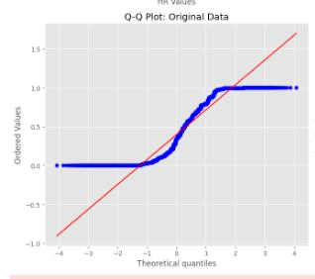
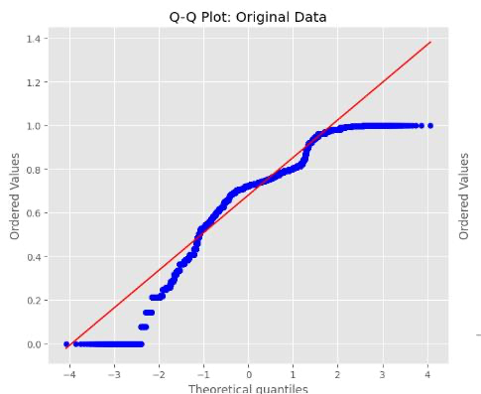
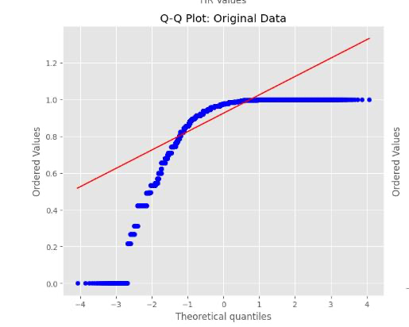
Issues within the Generated data
While analyzing the generated hydropathy files, we came across the following issues within the generated Hydropathy data.
Best case
High Variance
Skewed Data
Almost all the data had high Kurtosis
ZIMJ680101
PRAM900101
CASG920101

Slide 8

Impact on the model training
Unstable Gradients & Slow Convergence
Datasets with high kurtosis can lead to gradient instability during training, impairing a model’s capacity to capture complex patterns. ​
Batch Normalization Sensitivity
Batch Normalization (BN) assumes that activations are approximately normally distributed. Heavy-tailed distributions can skew BN's moving mean and variance estimates, reducing its effectiveness and causing shifts in activation distributions across batches. ​
Overfitting to Outliers
High-capacity CNNs may overfit to rare outlier data points, leading to poor generalization. ​
Gradient Explosion in Deep Networks
In CNNs, large activations from outliers can propagate through layers, exacerbating gradient explosion or vanishing issues.

Slide 9

Data Engineering
Origin Shifting
Noise Injection
Power
Transform
Min-Max Scala
Shift Ha·Hb values to ensure positivity and standardize input range.
Add Gaussian noise to enhance model robustness and generalization.
Normalize skewed data distributions for better model learning.
Scale features to [0, 1] for consistent neural network input.
Ensures all HaHb values are positive and compatible with the parabolic formula.
(Data Regularization)
Improves tolerance to data irregularities and simulates real-world variation.
Reduces skewness, making feature distributions more Gaussian for stability.
Facilitates faster convergence and balanced learning in neural networks.

Slide 10
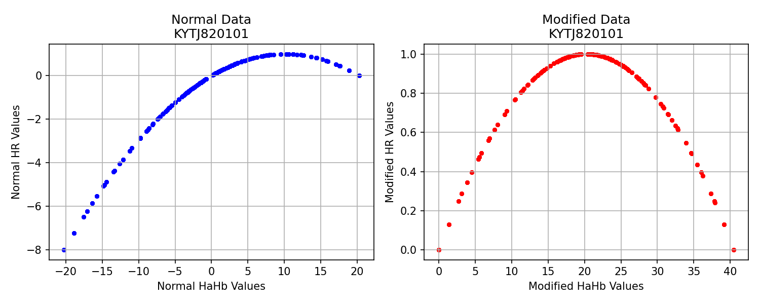
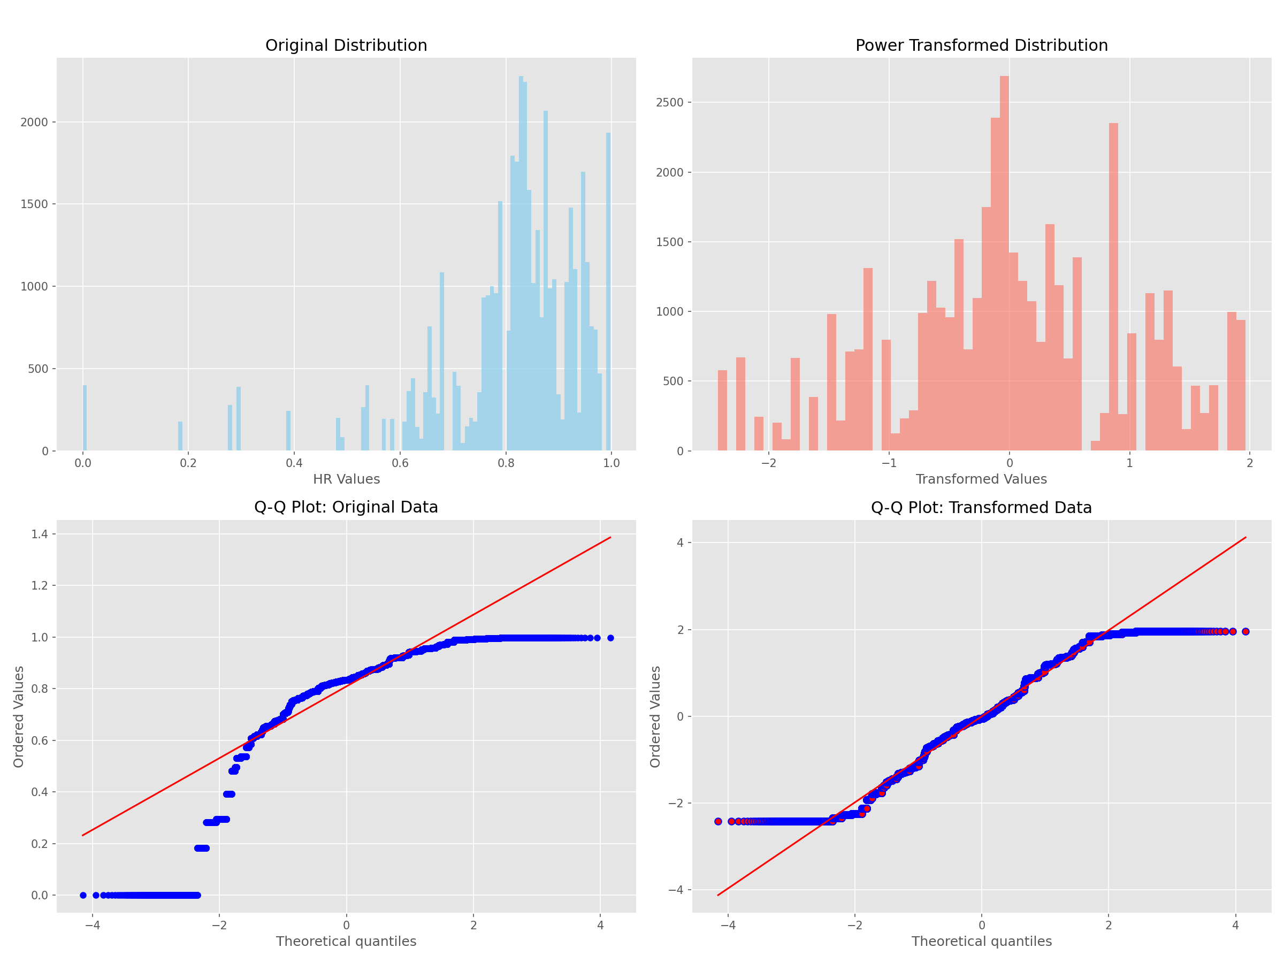
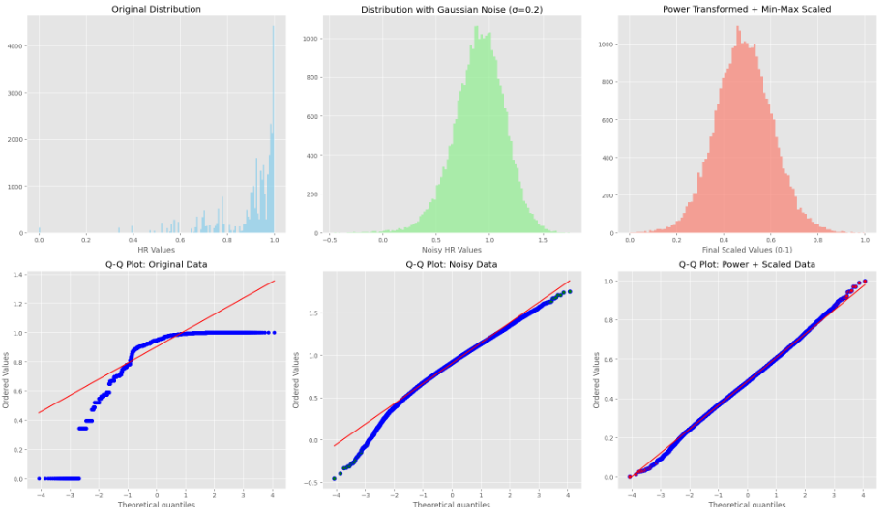
Origin shifting
Noise Injection
Power Transform

Slide 11
Model Design Phase

Slide 12


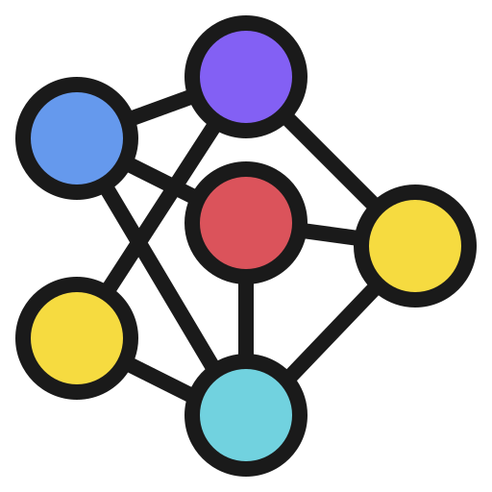
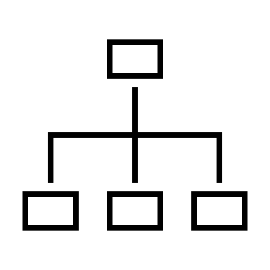
Phases of Model Training
Phase 1
Phase 2
Phase 3
Took the existing CIR-Net architecture and trained the model across all 28 scales.
Extended the architecture and applied hyperparameter tuning to optimize performance.
Adopted a statistical-based approach and implemented machine learning models for training.

Slide 13

Result Analysis of all the phases
L hydrophobicity scale
Accuracy = 76.93
Precision = 0.7660
Recall = 0.7619
F1- Score = 0.7640
ENGD860101
Accuracy = 80.52
Precision = 0.8077
Recall = 0.7937
F1- Score = 0.8006
(XG-Boost)
NADH010105
Accuracy = 78.57
Precision = 0.7795
Recall = 0.7857
F1- Score = 0.7826
Predicted Positives
Predicted Negatives
Predicted Positives
Predicted Negatives
Predicted Positives
Predicted Negatives
Actual Positives
480 (TP)
Actual Positives
Actual Positives
150 (FN)
500 (TP)
130 (FN)
495 (TP)
135 (FN)
Actual Negatives
146 (FP)
506 (TN)
Actual Negatives
119 (FP)
533 (TN)
Actual Negatives
140 (FP)
512 (TN)

Slide 14
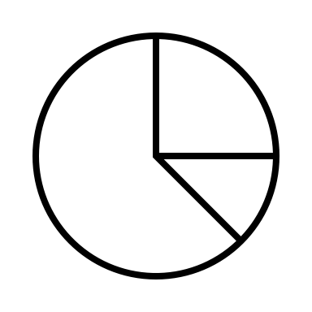
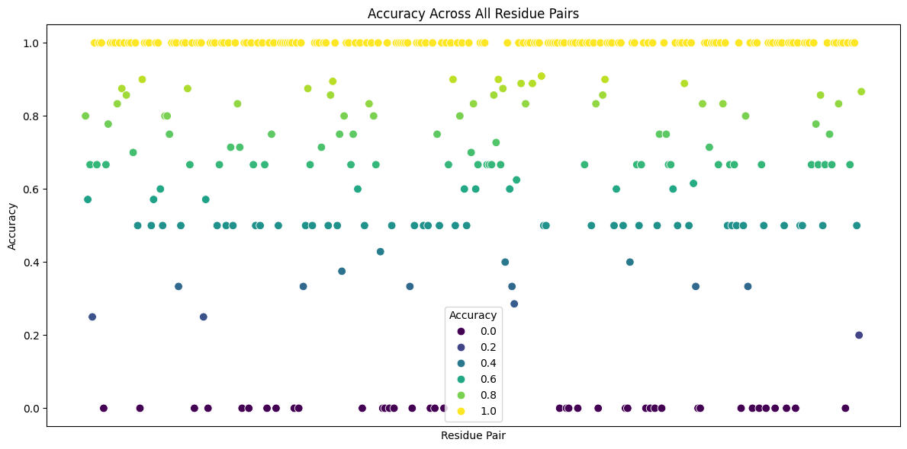
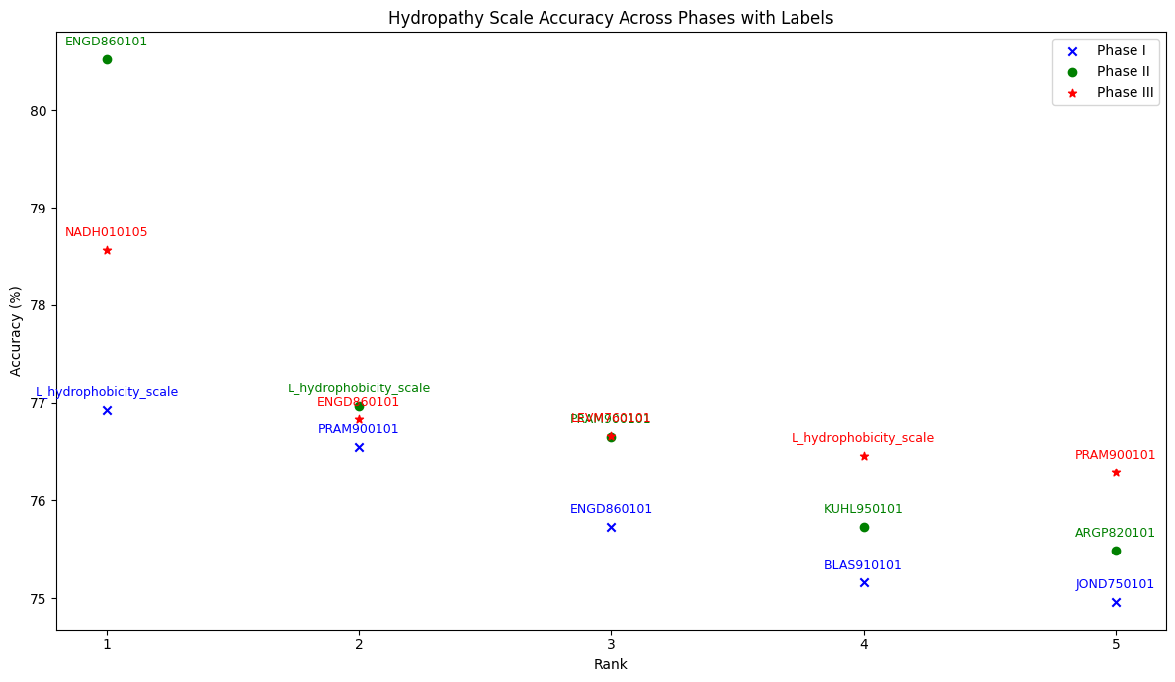
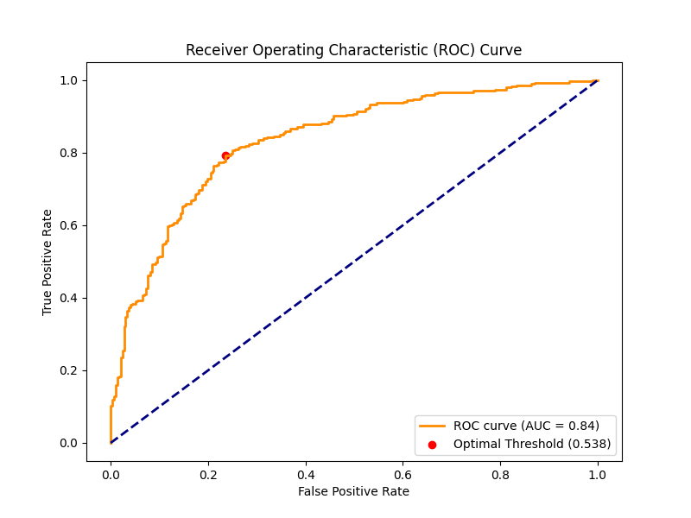
Visualize the Results
Threshold Value for Best scale:- 0.513
Visualizing accuracy over various phases of model training
ROC curve showing threshold for the best scale

Slide 15

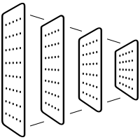
Future Enhancement Suggestions
CNN
ANN
Explore Alternative Architectures
Compare CNNs, ANNs and RNNs to better model residue pairs from the given features and hydropathy scales
B. Incorporate Transfer Learning
Pre-train on one hydropathy scale and fine tune on others to improve the results.
C. Integrate more features
Indicates how exposed each residue is to the surrounding solvent. ➔ Surface-exposed residues are more likely to participate in interactions.
Measures how much a residue stays unchanged across species. ➔ Highly conserved residues often play critical functional roles, including binding.

Slide 16
Task 2:
New Hydropathy Scale Construction

Slide 17
Method Selection
Derive an optimal unified hydropathy scale from individual 28 scales
Workflow
Why PCA?
28 Scales
Standardization
PCA
More robust than simple averaging or clustering.
Captures maximum shared variance
PC1
Unified Scale
Objective, avoids subjective weighting

Slide 18


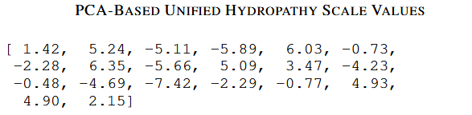
PCA Method for Unified Hydropathy Scale
Preprocessing
Align all scales to a fixed amino acid order.
Standardize using Z-score normalization.
Input: X ∈ ℝ^{20×28} (20 amino acids × 28 scales).
Extract First Principal Component (PC1).
PCA Approach
PCA Based Scale

Slide 19
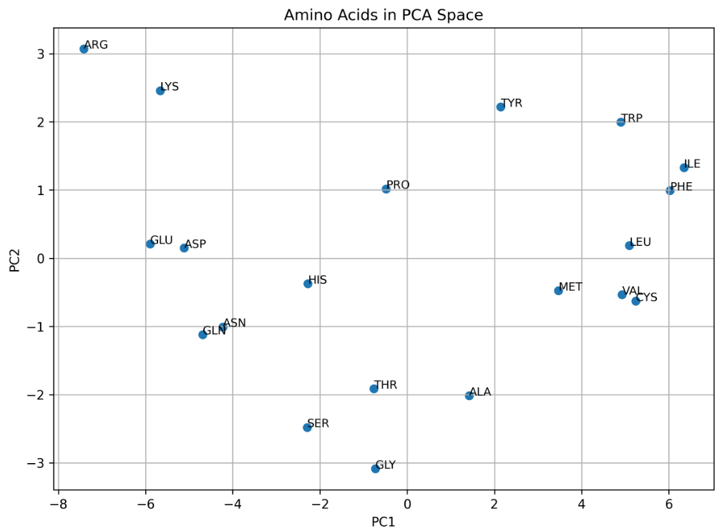
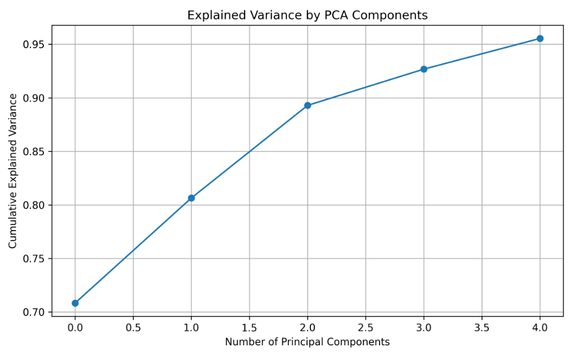
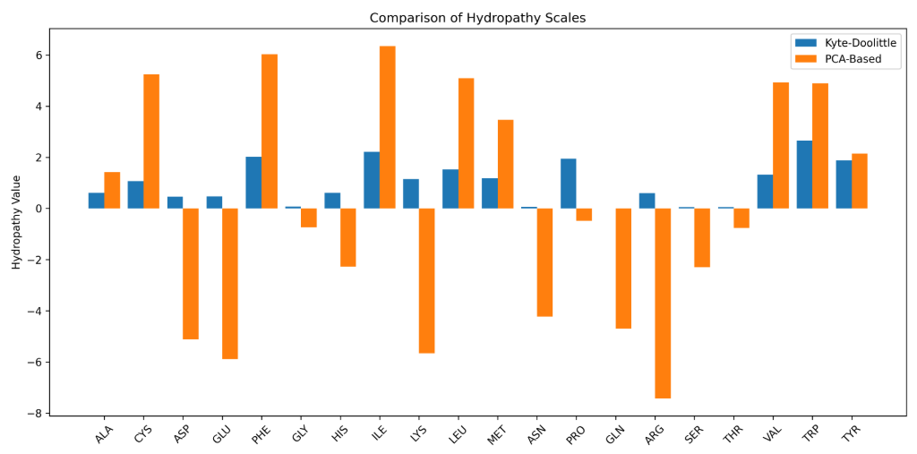
PCA Results
Amino Acid Clustering
Explained Variance
PC1 explains >70% variance.
PC1 + PC2 explain >90%.
Scale Comparison with Kyte-Doolittle
Indicates broader physicochemical features from multiple hydropathy models.

